Slide 1
TEACHER’S PERSONAL INFORMATION
Name: Nguyen Thanh Loan
Facebook: Loan Nguyễn Thanh
Mobile number: 0942 255 937
Email: loannguyenthanh1978@gmail.com

Slide 2

UNIT 7
DANGER

Slide 3
CONTENTS
Vocabulary: dangers, animals, fears and phobias.
Grammar: comparison, -ing forms and phobias.
Function: giving yourself time to think.

Slide 4
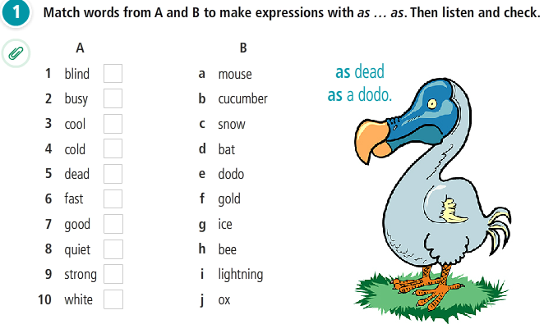
VOCABULARY PLUS
Idioms with as……..as

Slide 5
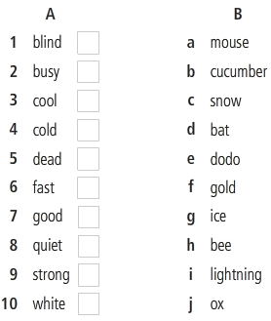
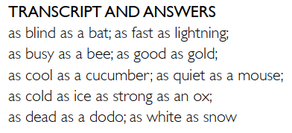

Idioms with as……..as
Thành ngữ là những câu nói không nhằm mục đích để hiểu theo nghĩa thông thường, đồng thời ý nghĩa của một thành ngữ thường là câu mang nghệ thuật ẩn dụ trong toàn bộ câu.

Slide 6
Idioms with as……..as
'As busy as a bee nghĩa là bạn là người bận rộn (như những chú ong chăm chỉ).
“as good as gold” dùng để tả về ai đó, khi bạn dùng thành ngữ này để kể hoặc nhận xét về ai đó như “he is as good as gold” nghĩa là anh ấy cực kì tốt và cư xử lịch sự. ...
"As cool as a cucumber" có nghĩa là "điềm tĩnh, không bị ảnh hưởng bởi sức nóng hay căng thẳng bên ngoài".
as quiet as a mouse im thin thít, câm như hến
'as blind as a bat' = mù như con dơi -> không nhìn thấy gì hoặc có tầm nhìn/thị lực rất kém hoặc không nhận ra những vấn đề hay chuyện xấu đang diễn ra.
'As quick as lightning' nghĩa là nhanh như (tia) chớp (incredibly quickly or speedily)

Slide 7
Idioms with as……..as
"as cold as ice" (lạnh như băng)
as strong as a horse/ an ox: khỏe như voi
“as dead as a dodo', thì có nghĩa là nó không còn quan trọng hay được ưa thích nữa.
"As white as snow" = Trắng như tuyết -> Trắng vô cùng/trắng bạch luôn, ví dụ nước da trắng như tuyết.

Slide 8
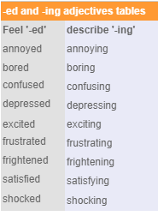
ING / ED ADJECTIVES
Form:
1. –ed adjectives
This book is very boring
He’s an interesting person.
2. -ing adjectives
I’m bored.
He’s interested in rock climbing.

Slide 9
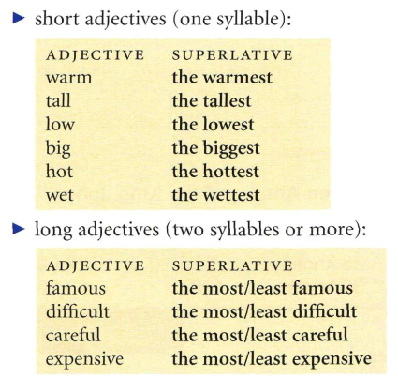
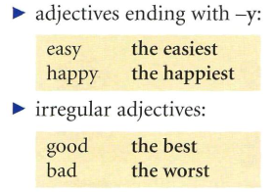
GRAMMAR
SUPERLATIVE ADJECTIVES

Slide 10
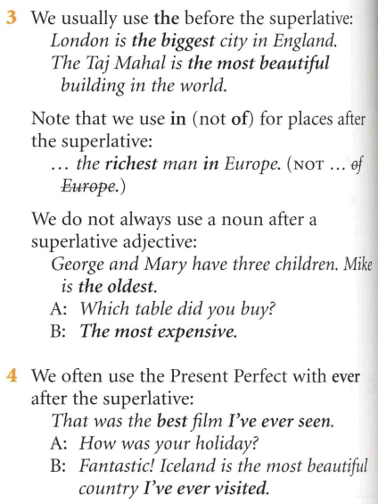
GRAMMAR
SUPERLATIVE ADJECTIVES

Slide 11
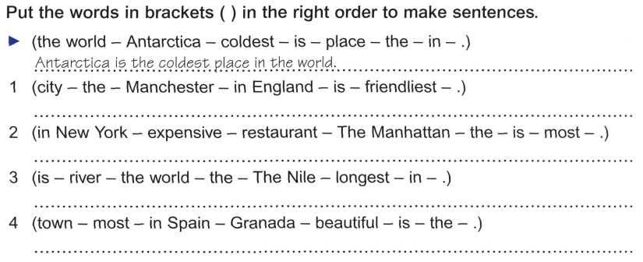
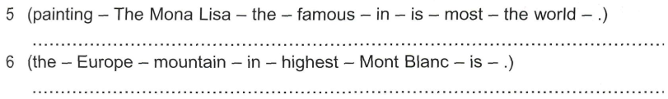
GRAMMAR
SUPERLATIVE ADJECTIVES

Slide 12
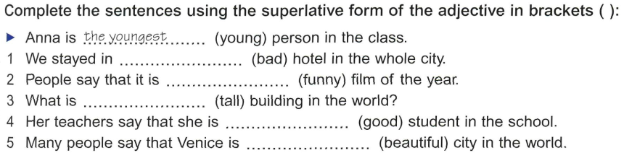
GRAMMAR
SUPERLATIVE ADJECTIVES

Slide 13
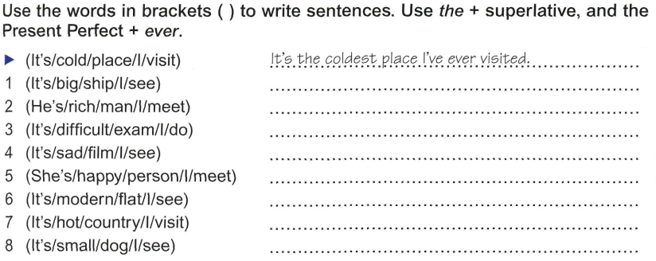
GRAMMAR
SUPERLATIVE ADJECTIVES

Slide 14
ING / ED ADJECTIVES
I was so annoyed with him for turning up late.
It's really annoying when a train is late and there's no explanation.
He was getting bored with/of doing the same thing every day.
The movie was so boring I fell asleep.
I'm a bit confused. Was that her husband or her son she was with?
The instructions are really confusing. Could you help me with them, please?
Are you getting excited about your holiday?
It was a really exciting match.
Which adjectives describe how a person feels about someone or something?
Which adjectives describe how a place, person or things?

Slide 15
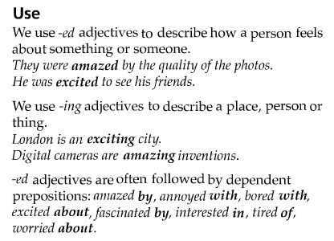
ING / ED ADJECTIVES
https://www.youtube.com/watch?v=KV0kid6Icqo

Slide 16
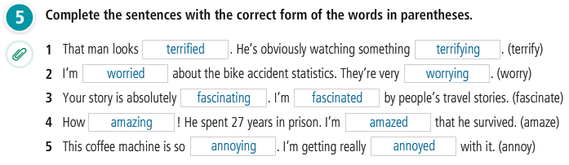
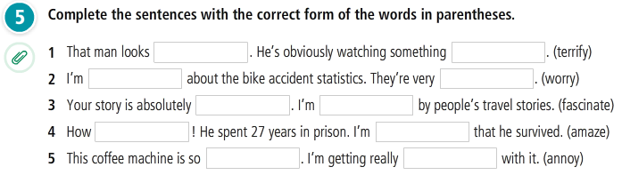
Practice
ING / ED ADJECTIVES

Slide 17
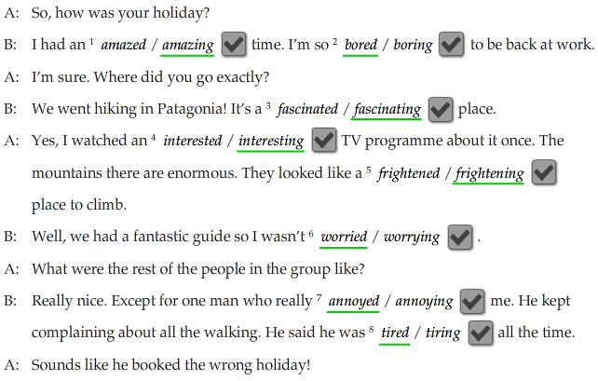
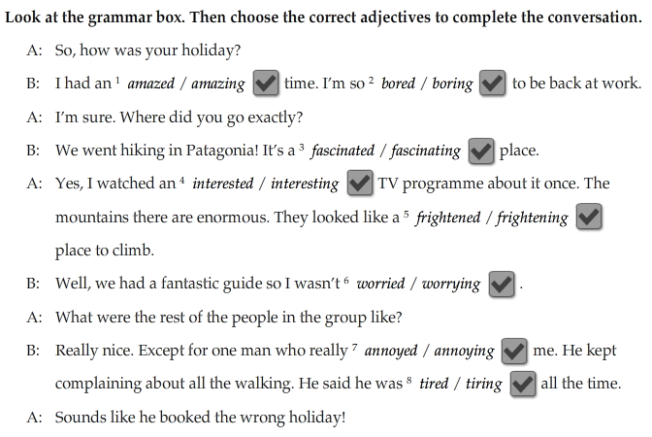

Slide 19
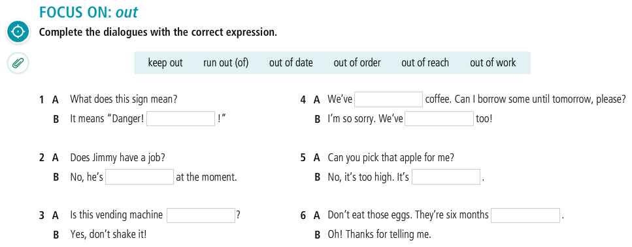
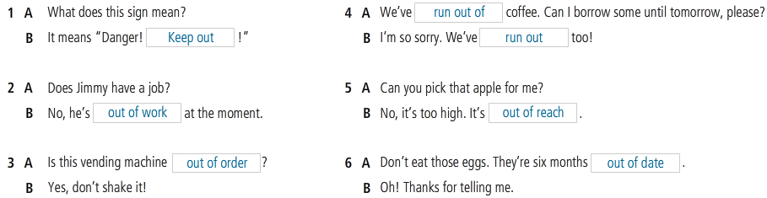
VOCABULARY PLUS

Slide 20
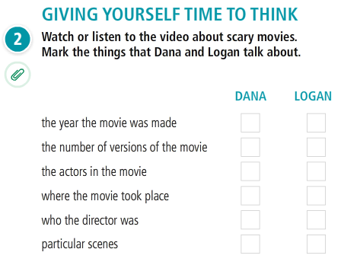
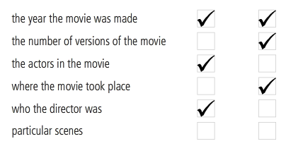
WRITING
LANGUAGE IN ACTION

Slide 21
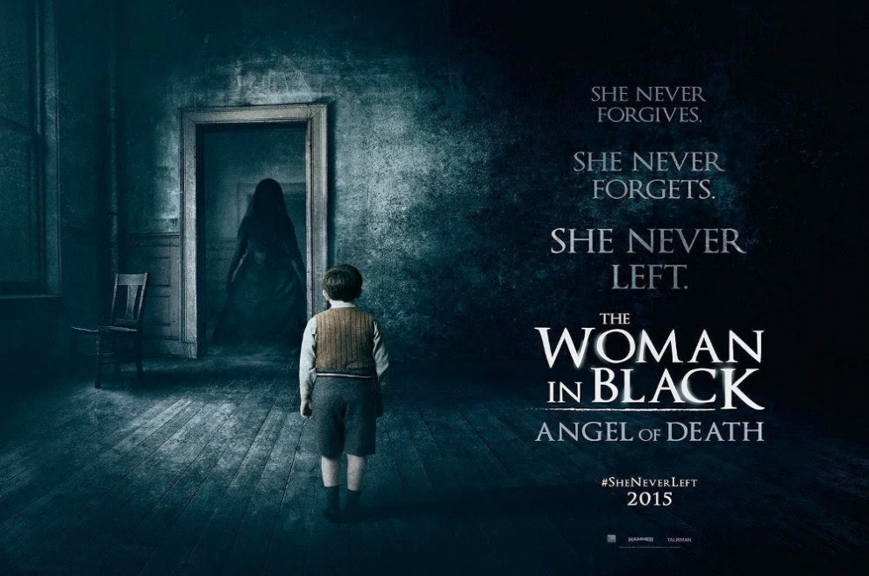

WRITING
MOVIE REVIEW
Read this short movie review about a scary movie.
My all-time favorite scary movie is The woman in black. It was made in 2012. The director is James Watkins, and it stars Daniel Radcliffe. It takes place in a small town in England at the beginning of the 20th century. It’s about a dead woman who comes back and terrifies the locals in the town. In my opinion, it’s a classic horror film since it isn’t full of violent scenes, but it’s very disturbing and very, very scary.

Slide 22
Match the questions with the answers
(1) What is the name of the movie?
(2) When was it made?
(3) Who is the director? and Who does it star?
(4) Where and when does it take place?
(5) What is it about?
(6) What is your opinion about the film? and Why?
The director is James Watkins, and it stars Daniel Radcliffe.
(b) It’s about a dead woman who comes back and terrifies the locals in the town.
(c) In my opinion, it’s a classic horror film since it isn’t full of violent scenes, but it’s very disturbing and very, very scary.
(e) It takes place in a small town in England at the beginning of the 20th century.
(d) My all-time favorite scary movie is The woman in black.
(f) It was made in 2012.

Slide 23
Match the questions with the answers
(1) What is the name of the movie?
(2) When was it made?
(3) Who is the director? and Who does it star?
(4) Where and when does it take place?
(5) What is it about?
(6) What is your opinion about the film? and Why?
(1) My all-time favorite scary movie is The woman in black.
(2) It was made in 2012.
(3) The director is James Watkins, and it stars Daniel Radcliffe.
(4) It takes place in a small town in England at the beginning of the 20th century.
(5) It’s about a dead woman who comes back and terrifies the locals in the town.
(6) In my opinion, it’s a classic horror film since it isn’t full of violent scenes, but it’s very disturbing and very, very scary.

Slide 24
WRITING
A MOVIE REVIEW
Each student prepares a piece of paper. Write the answer for each question as guided by teacher. Finish and read out loud to the class.
1. My all-time favorite scary/horror/terrifying movie is _______
2. It was made in _______.
3. The director is _______, and it stars _______.
4. It takes place _______ _______.
5. It’s about _______.
6. In my opinion, it is a _______ since/because it _______.

Slide 25
References
Grammar: Superlative adjectives
https://www.youtube.com/watch?v=K1Rs793CjqE
https://www.youtube.com/watch?v=pm9fq1MbR_I
https://www.youtube.com/watch?v=o2azbCBFMMc
Grammar: Ing / ed adjectives
https://www.youtube.com/watch?v=7pngzelkD-8
https://www.youtube.com/watch?v=nqsfLRsaCco
https://www.youtube.com/watch?v=7tcS8Ll6YnM
https://www.youtube.com/watch?v=cKMMnLOBQ60
https://www.youtube.com/watch?v=nqsfLRsaCco&t=193s

Slide 26
The end!

